Slide 1


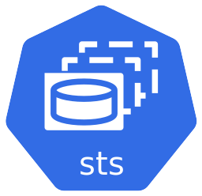







kasten-io
stock-demo
Remote Storage
argocd
User

Slide 2

kasten-io
mysql
Remote Storage
argocd
User

Slide 3

kasten-io
mysql
Remote Storage
argocd
User

Slide 4
kasten-io
stock-demo
Export
Snapshot
Remote Storage
argocd
Pre-sync
Sync
User
git commit

Slide 5

kasten-io
stock-demo
Remote Storage
argocd
Sync
User
git commit

Slide 6
kasten-io
stock-demo
Restore
Remote Storage
argocd
User

